Slide 1
WEEK # 3
Conjunction and its types

Slide 2
CONJUNCTIONS:
used to join or glue words, phrases, and clauses.
For example,
I bought pens and pencils. [the words ‘pens’ and ‘pencils’ are joined by ‘and’]
I will do it this evening or tomorrow morning. [the phrases ‘this evening’ and ‘tomorrow morning’ are joined by the conjunction ‘or’]
When you aren’t here, the house seems very empty. [the conjunction ‘when’ has joined the two clauses]

Slide 3
Life without conjunctions:
I would love to go out to eat with you. I would love to go out to eat with Krista. I would love to go to the movies with you. I would love to go to the movies with Krista. My mom says I can't. My mom says I might have to do my homework. My mom says I might have to clean up my room. The reason is this: I broke my curfew last weekend.
Life with conjunctions:
I would love to go out to eat and to the movies with you and Krista, but my mom says I have to either do my homework or clean up my room because I broke my curfew last weekend.

Slide 4
Types of Conjunction
Coordinating Conjunction
Subordinating Conjunction
Correlative Conjunction

Slide 5
Coordinating Conjunction (CC)
join independent clauses or other elements (words and phrases) of equal importance.
For example,
Gary lives in Ohio, and Deana lives in Michigan.
She loves to dance, so she bought a studio.
You could buy a car, or you could put the money in the bank.
I hate to cook, but I love to bake.
It is necessary to put a comma before a CC, in case of clauses. The chief CCs are: FANBOYS

Slide 6
Exercise: Find the mistakes in these sentences and correct them.
I want new rollerblades. And I want new games for the computer for my birthday.
Kate ate a plate of spaghetti, and a salad.
Meg got dressed and headed out for her horseback lesson and got there early and she groomed her horse slowly.
Neither Tina or Brian was able to go with us to the game.

Slide 7
Answers
1. "I want new rollerblades, and I want new games for the computer for my birthday."
2. "Kate ate a plate of spaghetti and a salad."
3. "Meg got dressed, headed out for her horseback lesson, arrived there early, and groomed her horse slowly."
4. "Neither Tina nor Brian was able to go with us to the game."

Slide 8
Subordinating Conjunction (SC)
join dependent clauses with independent clauses.
Unlike the CCs, they become part of the clause they join, and so make the resulting clause a dependent (subordinating) clause.
For example:
Although she was ill, she attended the conference.
If you don’t stop, I will shoot.
The concert had already started when we arrived.
If SC comes in the beginning of the sentence, a comma is required to separate the clause from the main clause.

Slide 9
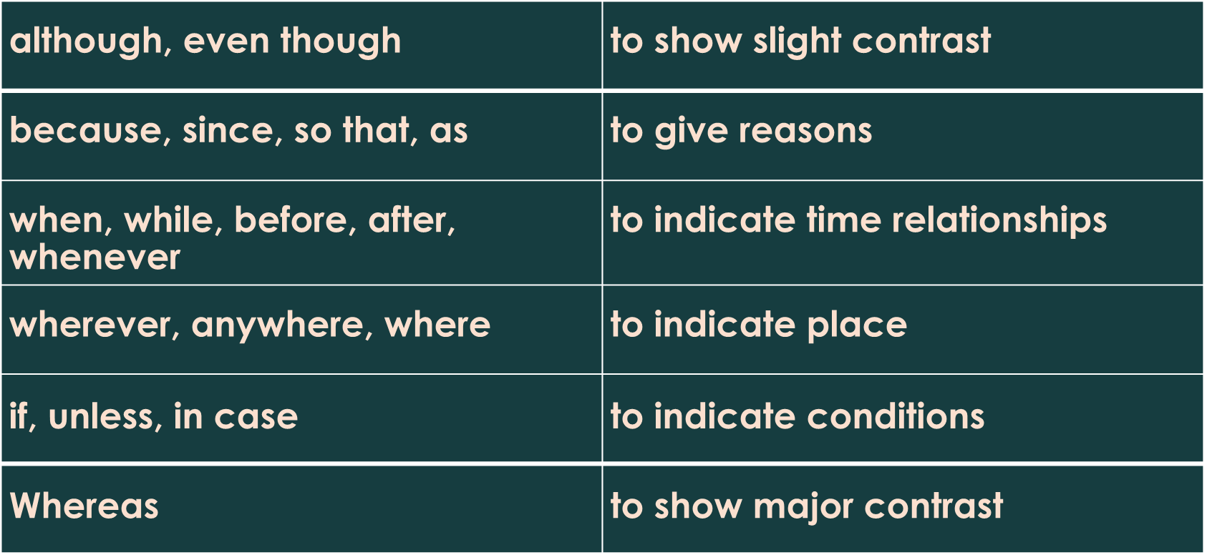
Some common SCc are:

Slide 10
Exercise # 9: Join the following sentences
Mitchell prefers watching romantic films. He rented the latest spy thriller. He enjoyed it very much. (although, and)
Laura forgot her friend's birthday. She sent her a card. She finally remembered. (so, when)
The team captain jumped for joy. The fans cheered. We won the state championship. (and, because)
My sister was exhausted. She kept running. She got first place. (yet, and)
Do the remaining ones at home

Slide 11
Correlative Conjunction
Correlative conjunctions are paired words.
They join words, phrases, or clauses having reciprocal or complementary relationship.
For example:
We may buy either a camera or a laptop.
She likes neither tea nor coffee.
Both pink and blue are nice colours.
She is interested not only in singing but also in games.
Common Correlative Conjunctions: either… or, neither… nor, not only… but also, both… and, whether… or

Slide 12
Exercise 7: Choose the best answer to complete each sentence.
She is neither polite funny.
that is the case, I’m not surprised about what’s happening.
Have you made a decision about to go to the movies not?
had I put my umbrella away, it started raining.
This salad is delicious healthy.

Slide 13
Exercise # 8: Join the following sentences:
Mum was working in the garden. Dad was preparing the meal. [and]
I try to run. My leg hurts. [when]
I don’t know. We should be doing this or not. [whether]
Do the remaining ones at home

Slide 14
Exercise # 13: fill in the blanks with the correct subordinate conjunctions or similar expressions.
I went for a walk _ the sun was shining. (because, otherwise)
Do you know the stores are open today? (if, whether)
We recognized her at once, we had not seen her for years. (although, in case)
He kept reading he fell asleep. (for, until)
It looks _ the train will be late. (while, as though)
What shall we do it rains? (or else, supposing)
The door was open, _ we could hear everything. (in case, so)
I will join you, _ the weather is fine. (providing, than)
Do the remaining ones at home

Slide 15
Conjunctive Adverb
Conjunctive adverbs are not real conjunctions, but they function as conjunctions
They are a type of adverb that connects two independent clauses or sentences by showing the relationship between them.
They are also known as transitional words and are used to smooth the transition between two sentences.

Slide 16
Some examples of conjunctive adverbs are:
moreover, additionally, however, therefore, hence, similarly, besides, finally, then
Major Functions:
Joining sentences inside a paragraph.
Joining paragraphs inside an essay.
Indicating the writer’s shift from one idea to another.
For example:
“English communication skills are a must for a successful career. First, English is the official language of Pakistan. Also, it is the lingua franca of the world. In addition, it is the language of science and technology. Hence, English language proficiency is very important for a good career.”

Slide 17
When using adverbial conjunctions, you must precede them with a semicolon/full stop and follow them with a comma.
Examples:
Jeremy kept talking in class; therefore, he got in trouble.
She went into the store; however, she didn’t find anything she wanted to buy.
I like you a lot; in fact, I think we should be best friends.

Slide 18
SENTENCE CONNECTOR TYPES:
1. ADDITIVES/LISTERS: They are used to add more points, or list down points. (EXERCISE)
2. COMPARATIVES: They are used to show similarity between ideas.
3. CONTRASTIVES: They are used to show contrast between ideas.
4. EXAMPLE WORDS: These connectors are used to give examples.
5. CONCLUDERS: They are used to summarize ideas.
6. TO SHOW CAUSE AND EFFECT: They are used to express consequences or results.
7. TO SHOW PURPOSE:
8. TO EMPHASIZE:
9. TO SHOW TIME:
10. TO REPEAT:

Slide 19
Exercise 14: Fill in the blanks.
[Similarly, therefore, then, nevertheless]
The Interact Club has done well to help the poor. , the Welfare Club has done well too.
The documents will be scrutinsed by the police._ they will be sent back to the relevant authority.
The retailer has been making losses. , he intends to wind up his business.
Life in the village may not be as exciting as life in the city. _, you are close to nature which provides peace and quietness.
Lopez has experienced poverty and hardship before. , he has a sympathetic heart towards the poor and needy.

Slide 20
Exercise 17: Fill in the blanks.
1. Your aunt is resting in the next room. So walk softly _______ disturb her. [so as to, in order to, so as not to, so that]
2. _______ you are so interested, I won’t persuade you to give up. _______ do check with the agent before you purchase it. [if/in order, as/however, unless/though, because/so]
3. Tea should be served in every meeting _______ the members will not be sleepy. [although, even if, as, so that]
4. The boys encountered lots of problems _______ trying to get to the island. _______ they managed to reach the island in time before the sharks came. [while/nevertheless, during/nevertheless, then/however, as/however]
5. _______ the monsoon season, the fisherman managed to obtain a good income. [even, as, although, in spite of]

